Slide 1
Java Architecture

Slide 2
Java Architecture in a nutshell
The code written in Java, is converted into byte codes which is done by the Java Compiler.
The byte codes, then are converted into machine code by the JVM.
The Machine code is executed directly by the machine.

Slide 3
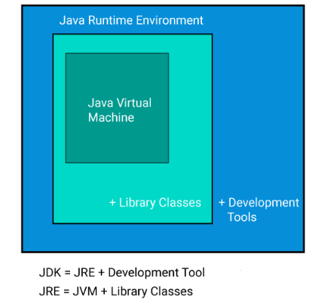
High level diagram of JVM

Slide 4
Development tools
java : it is the launcher for all the java applications.
javac : complier of the java programming languages.
javadoc: it is the API documentation generator.
jar: creates and manage all the JAR files.

Slide 5
How is Java platform independent?
When is any programming language called as platform-independent?
if and only if it can run on all available operating systems with respect to its development and compilation. Now, Java is platform-independent just because of the bytecode.
Bytecode is a code of the JVM which is machine-understandable. Bytecode execution in Java proves it is a platform-independent language. steps involved in the process of java bytecode execution.
sample.java → javac (sample. class) → JVM(sample.obj) → final output

Slide 6
Behavior of JVM
Is JVM available any time ?
No …then ,
Until a JAVA application runs ,a JVM instance is executing ,IF not it will die ,
When
There is no any non daemon threads
OR
Application suicide by the System. Exit()

Slide 7
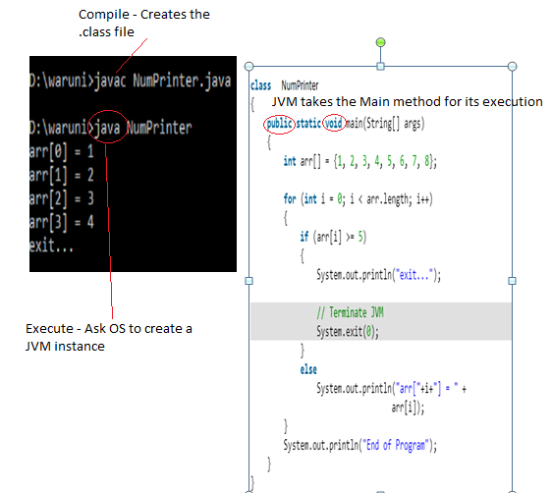

Slide 8
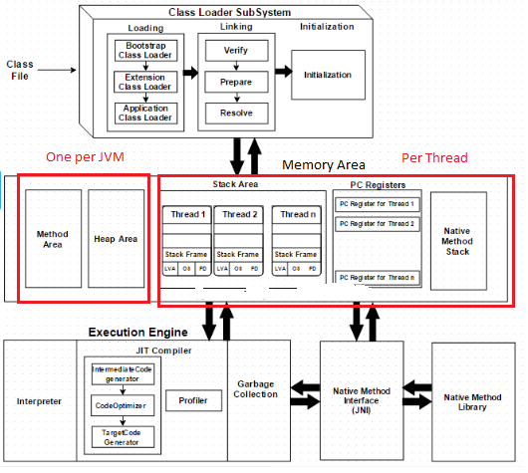
JVM Architecture Diagram

Slide 9
Loading
The Class loader reads the .class file, generate the corresponding binary data and save it in method area. For each .class file, JVM stores following information in method area.
Fully qualified name of the loaded class and its immediate parent class.
Whether .class file is related to Class or Interface or Enum
Modifier, Variables and Method information etc.

Slide 10
After loading .class file, JVM creates an object of type Class to represent this file in the heap memory.
For every loaded .class file, only one object of Class is created.
Linking
Performs verification, preparation, and resolution.
Verification :
It ensures the correctness of .class file
Check whether this file is properly formatted &
generated by valid compiler or not.
If verification fails, we get run-time exception java.lang.VerifyError. That defines the file has been altered .

Slide 11
So , as a result of the Bytecode Verifier , JAVA gets the safety to run .
Preparation :
JVM allocates memory for class variables and initializing the memory to default values.
Resolution :
It is the process of replacing symbolic references from the type with direct references. It is done by searching into method area to locate the referenced entity.

Slide 12
Initialization
In this phase, all static variables are assigned with their values defined in the code and static block(if any). This is executed from top to bottom in a class and from parent to child in class hierarchy.
Every class must be initialized before its active use.
Variations of being a Active use of a Class
When creating a object
New key word - Student s1 = new Student ();
Invoking a Static method (When object is not created)
If Student class has a method called “verify”
Student.verify();

Slide 13
Assign a value for the static field ,
Student.grade= “one” ;
( If the variable declared as final , will not be considered for Initialization)
Initial class – (main)
getInstance(); - Reflection
Instantiation of a sub class

Slide 14
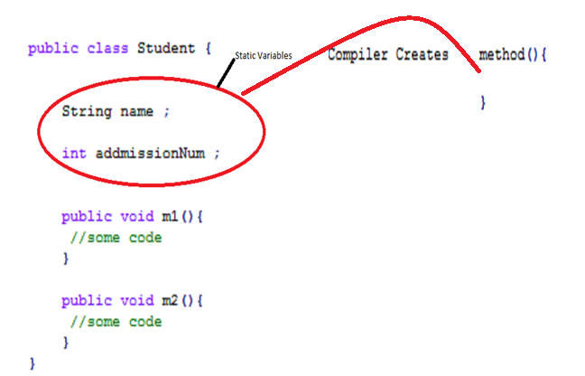

Slide 15
Ways of Initializing a class by JAVA
New key word
Clone() ; - Assign initial value from Parent class
getInstance();
IO.ObjectInputStream ;

Slide 16
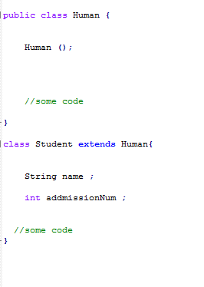
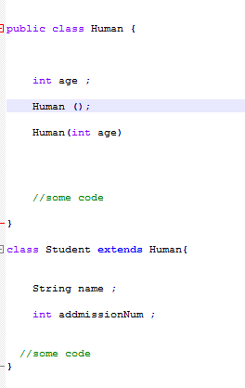
How JAVA go through constructors and instantiate parent class

Slide 17
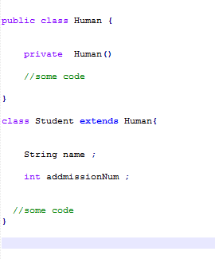
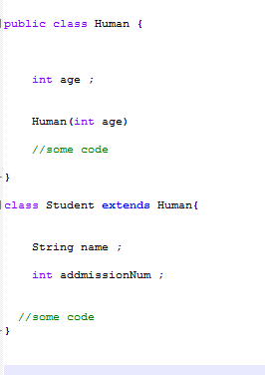
When pervious scenario will not be happened

Slide 18
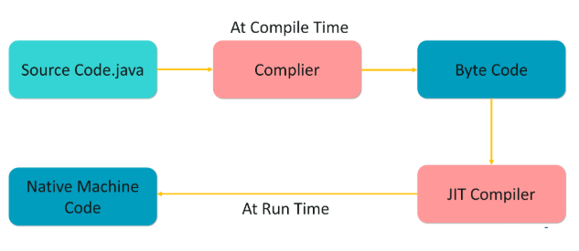
JIT in Java
Just In Time compiler commonly known as JIT, is basically responsible for performance optimization of java based applications at run time. The performance of an application is dependent on a compiler.

